Slide 1

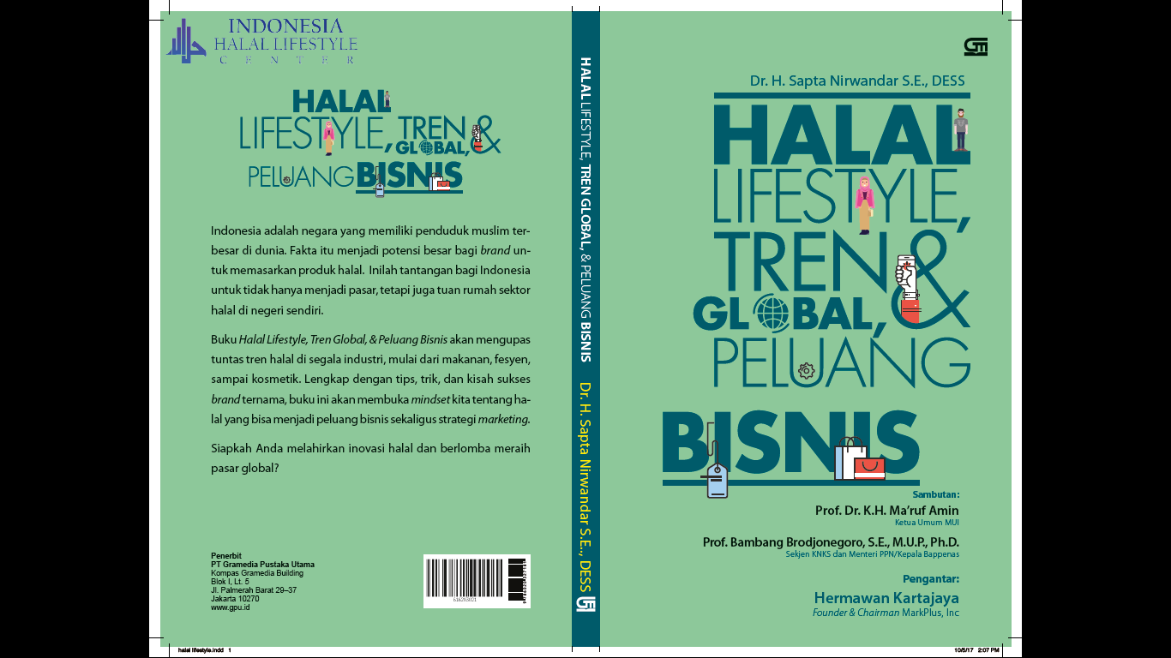
Dr. H. Sapta Nirwandar, SE
ISLAMIC ECONOMICS & FINANCE :
PRESENT AND FUTURE
Senin, 19 Maret 2018 – Sentral Senayan 3

Slide 2

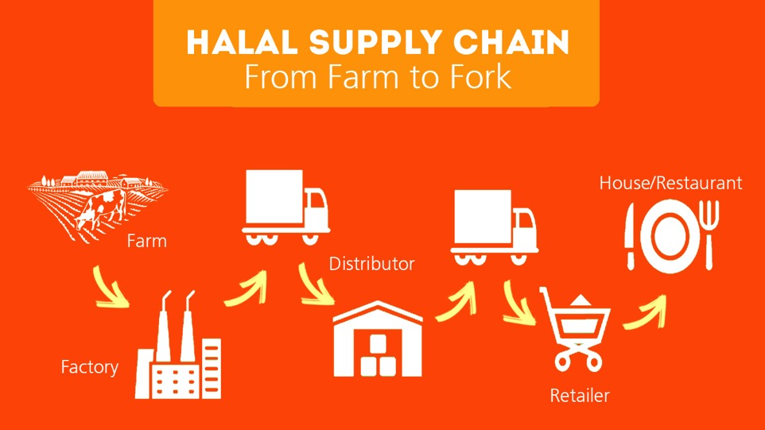

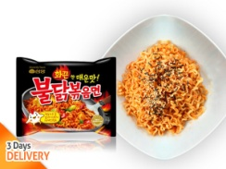






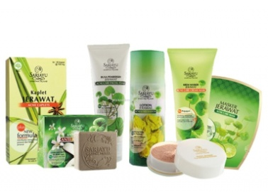


Industri Hilir
HALAL SUPPLY CHAIN
- From farm to fork
- From farm to port
Makanan
House/ Restaurant
Halal Hub/ Port
Retailer
Fashion
Halal Park
Kosmetik
Distributor
Apps
Factory
Standarisasi
Sertifikasi
Akreditasi
UUD No 33 Tahun 2014
© Indonesia Halal Lifestyle Center, 2018

Slide 3
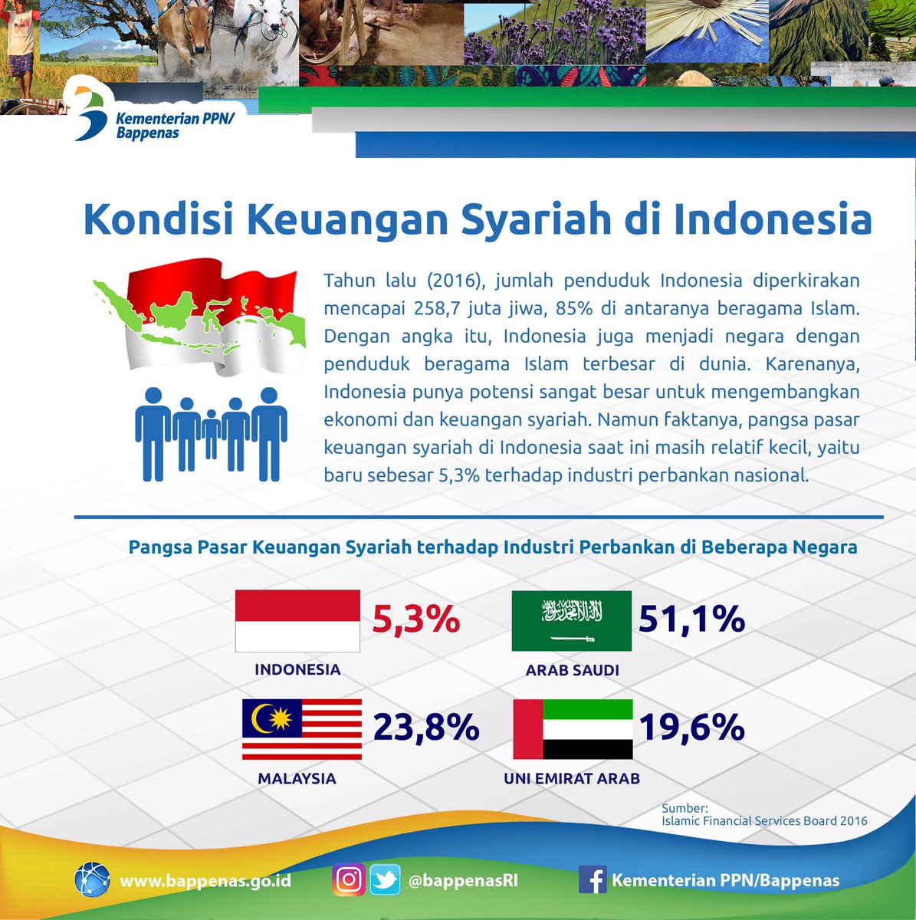













Industri Keuangan Syariah & Industri Non Keuangan Syariah
Keuangan Syariah :
Perbankan Syariah
Pasar Modal Syariah
Industri Keuangan Non Bank Syariah
Sektor Riil
Halal Lifestyle Sektor
Bank Wakaf
Bank Muamalat
Pangsa Pasar
Bank Syariah
food and beverages
tour and travel
fashion
cosmetics
and care
Visi dan Koordinasi Pemerintah Otoritas
Modal yang belum memadai
Efisien
Produk & Pelayanan
SDM & Technologi
Pemahaman & Kesadaran Masyarakat
pharmaceutical
financial
media and recreation
health
Hambatan
Bank Syariah :
education
art and culture
Sumber : ROADMAP PENGEMBANGAN KEUANGAN SYARIAH INDONESIA 2017-2019
© Indonesia Halal Lifestyle Center, 2018

Slide 4
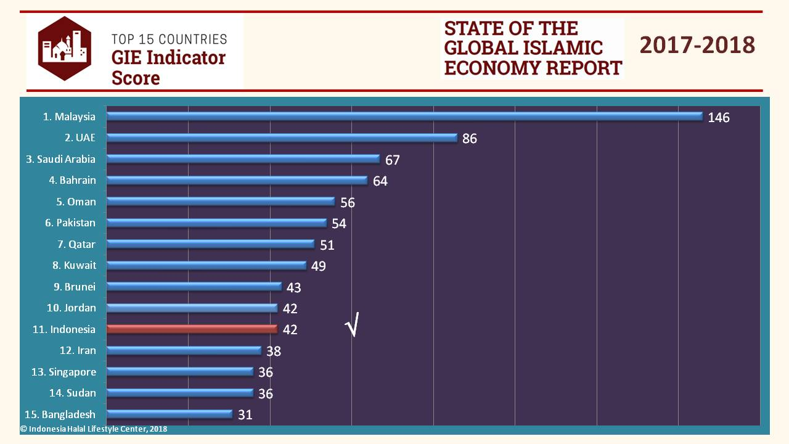
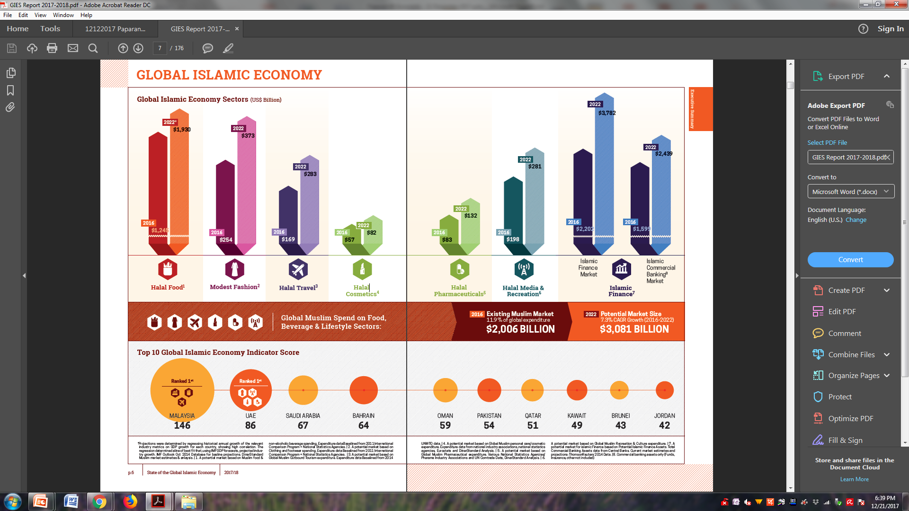
Ekosistem
Halal Industri
“Global Islamic Economy 2017-2018” Indonesia turun ke peringkat 11.
© Indonesia Halal Lifestyle Center, 2018

Slide 5



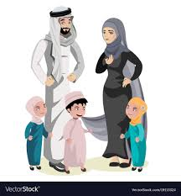
Domestic
Market Size
Global
OIC & non OIC
Potensi Besar
PDB Tinggi
Middle Class Meningkat
© Indonesia Halal Lifestyle Center, 2018

Slide 6
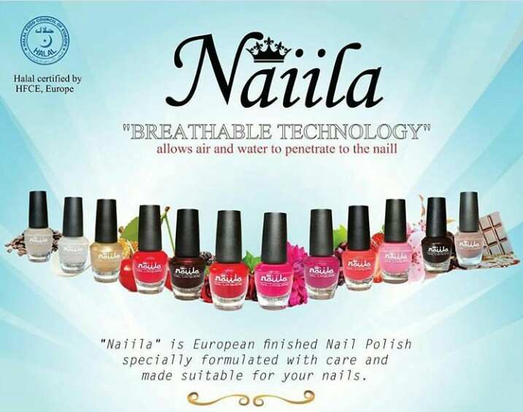
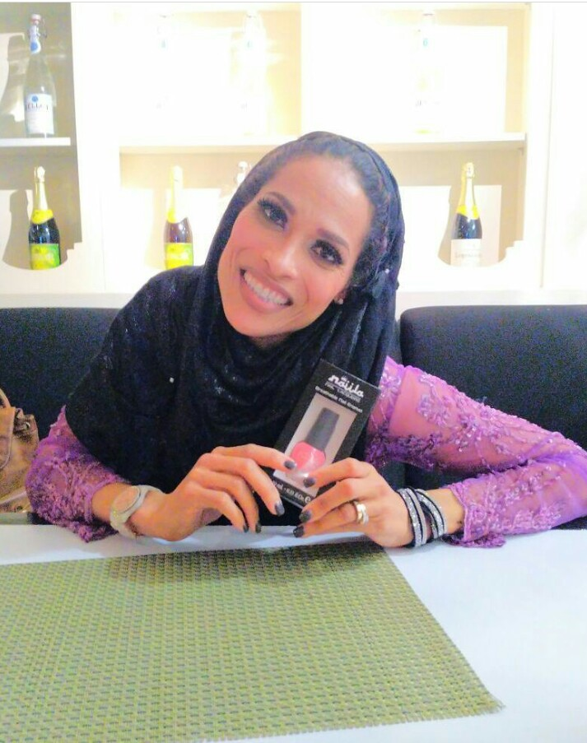
Nail Polish Halal
Indonesia Halal Center Jl. Tanah Abang I no 12 JJ
Rasshida Ali @Sentul 2017
Contact : 081385800984 (Tia)

Slide 7
Halal Lifestyle
Tren Global & Peluang Bisnis
Pasar Dan Ekonomi Global
Apa Itu Halal Lifestyle
Super Lembaga
Roadmap dan Kebijakan Industri Halal
Brand Success Story
Informasi Pemesanan :
081905383323 (Aisyah)

Slide 8


Slide 9
WWW...
Wassalamuallaikum
Warrahamtulahi
Wabbarakatuh

